Slide 1


CAPSTONE PROJECT
AI-Based Research Gap
Identification System
using Large Language Models
College Name -: SRM IST KTR Chennai
Chirag Paul
Computer Science & Engineering

Slide 2
PRESENTATION FLOW
Outline
Problem Statement
Motivation
Challenges in literature review
Why this system is needed
Proposed Solution
System Architecture
AI-powered web application
Technical design overview
Technology Stack
Algorithm Workflow
Tools & frameworks used
Step-by-step process
LLM Prompt Structure
Deployment
JSON schema & parsing
Backend & frontend setup
Results
Advantages & Limitations
Sample output & UI
System evaluation
Future Scope
Conclusion & References
Planned enhancements
Summary & citations

Slide 3
THE CHALLENGE
Problem Statement
Exponential Growth of Research
The Research Bottleneck
Research publications are growing exponentially across platforms like arXiv, IEEE, and Springer, making it impossible for researchers to keep pace with manual review.
Research Papers
Thousands published daily
Time-Consuming Manual Process
Traditional literature review requires researchers to manually read, analyze, and synthesize hundreds of papers—a process that can take weeks or months.
Confusion
Information overload
Difficulty in Identifying Key Insights
Researchers struggle to identify:
Time Consumption
Emerging research trends
Research gaps
Weeks of manual work
Novel ideas
Future directions
Lack of Automated Gap Scoring
Papers per day
500+
No existing system provides quantitative gap scoring to help researchers prioritize which research areas have the highest potential impact.
On arXiv alone

Slide 4
WHY THIS MATTERS
Motivation
Student Challenge
Research Workflow Gap
Students struggle to select innovative project topics due to limited exposure to current research trends and gaps. Many end up choosing outdated or over-researched areas.
1
Manual paper search
2
Individual reading
Researcher Need
3
No automated analysis
Researchers need quick literature insights to stay updated in their fields without spending excessive time on manual paper reading and analysis.
4
Missed opportunities
Academic Requirement
Our Solution Bridges This Gap
Academia requires automated research intelligence tools to enhance productivity and enable data-driven decision making in research direction.
Growing AI Importance
80%
10x
AI
The growing importance of AI-assisted research tools is transforming how academia approaches literature review and research discovery.
Time Saved
More Papers
Powered

Slide 5
OUR APPROACH
Proposed Solution
An AI-powered web application for automated research gap identification
System Flow
Core System Components
Data Fetching
Text Extraction
User Input
Fetches recent papers from arXiv API based on user research topic
Extracts abstracts from papers for analysis
Fetch Papers
Embedding Generation
Clustering
Converts text into semantic embeddings using transformer models
Uses KMeans clustering to detect research trends
AI Processing
JSON Output
LLM-Powered Analysis
Leverages state-of-the-art Large Language Models (Gemini / HuggingFace) to generate intelligent insights:
UI Display
Trends
Gaps
Ideas
Future
Score
Fast
Smart
Reliable
Current patterns
Missing areas
Project topics
Directions
Gap rating

Slide 6
TECHNICAL DESIGN
System Architecture
User
Streamlit
Flask
Frontend
Backend
arXiv API
Embedding
KMeans
LLM
Paper Fetching
Model
Clustering
Gemini/HF
JSON Output
Frontend
Structured Results
Display
Frontend Components
Backend Components
Streamlit - Interactive web framework
Flask - REST API framework
Custom CSS - Glassmorphism UI
Flask-CORS - Cross-origin support

Slide 7
TOOLS & FRAMEWORKS
Technology Stack
Frontend
Backend
Streamlit
Flask
Interactive web apps
Web framework
Requests
Flask-CORS
HTTP library
Cross-origin resource sharing
Custom CSS
Sentence Transformers
Glassmorphism styling
Text embeddings
Scikit-learn
KMeans clustering
Environment
NumPy
Python-dotenv
Numerical computing
Environment variables
arXiv Python API
REST Architecture
Paper fetching
API design pattern
Google Generative AI
Gemini LLM
HuggingFace API
Alternative LLM

Slide 8
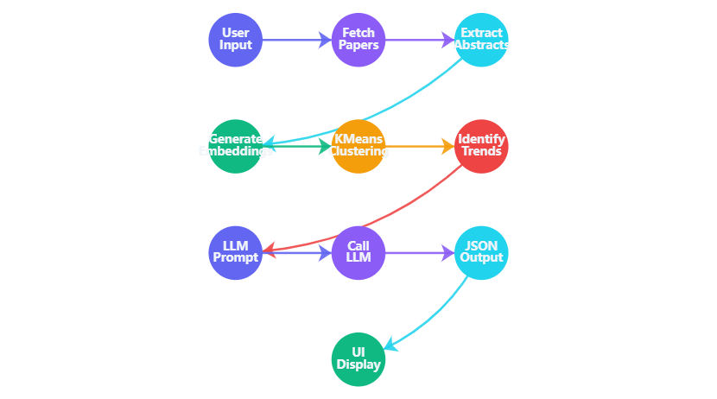
IMPLEMENTATION DETAILS
Algorithm Workflow
1
User Input
Complete Workflow Visualization
User inputs research topic or keyword query
2
Paper Fetching
Fetch 10 latest papers from arXiv API
3
Abstract Extraction
Extract abstracts from each paper
4
Embedding Generation
Generate embeddings using sentence-transformers/paraphrase-multilingual-MiniLM-L12-v2
5
Clustering
Apply KMeans clustering with n_clusters = min(3, number_of_abstracts)
6
Trend Identification
< 2 min
10 papers
AI + ML
Identify research trends from clusters
Processing time
Analyzed
Technologies

Slide 9
AI PROMPT ENGINEERING
LLM Prompt Structure
JSON Output Schema
Prompt Construction Flow
// Strict JSON format - No markdown allowed
Research Context
{
Topic + abstracts
"trends"
: [
"3-5 current research trends identified"
],
Cluster Analysis
"gaps"
Trend patterns
: [
"3 identified research gaps"
],
"ideas"
Structured Prompt
: [
With schema rules
"3 suggested project ideas"
],
"future_work"
: [
"2-3 future research directions"
LLM Processing
],
Gemini/HF
"gap_score"
: "score out of 10"
}
Validation
JSON format check
Error Handling & Validation
Strict JSON
No Markdown
Robust
Parsing enforced
Pure JSON only
Error handling
Gemini Pro
HuggingFace

Slide 10
SYSTEM DEPLOYMENT
Deployment Architecture
Frontend Deployment
Backend Deployment
Streamlit App
Flask Server
Interactive web interface
Runs on localhost:5000
$ streamlit run app.py
$ python app.py
* Local URL: http://localhost:8501
* Running on http://127.0.0.1:5000
Timeout Configuration
REST API Endpoints
Request timeout set to 120 seconds for LLM processing
GET
/
- Home
GET
/health
- Health check
POST
/analyze
- Analysis
Environment Variables
GEMINI_API_KEY=your_key_here
HF_TOKEN=your_token_here
ANALYSIS_PROVIDER=gemini|huggingface

Slide 11
SYSTEM OUTPUT
Results & Sample Output
Sample UI Output Layout
Key Features
Current Research Trends
Identified Research Gaps
Automatic Detection
Transformer-based architectures
Limited cross-domain studies
Trend identification
Few-shot learning approaches
Scalability challenges
Multimodal integration
Interpretability issues
Semantic Clustering
ML-based grouping
Suggested Project Ideas
Future Directions
AI-Driven Insights
Hybrid attention mechanisms
Real-time adaptation systems
LLM-powered analysis
Domain adaptation framework
Energy-efficient models
Explainable AI pipeline
Quantitative Scoring
Gap score out of 10
Research Gap Score
8.5 / 10
High Potential
Processing Metrics
< 2 min
10
Avg. response time
Papers analyzed

Slide 12

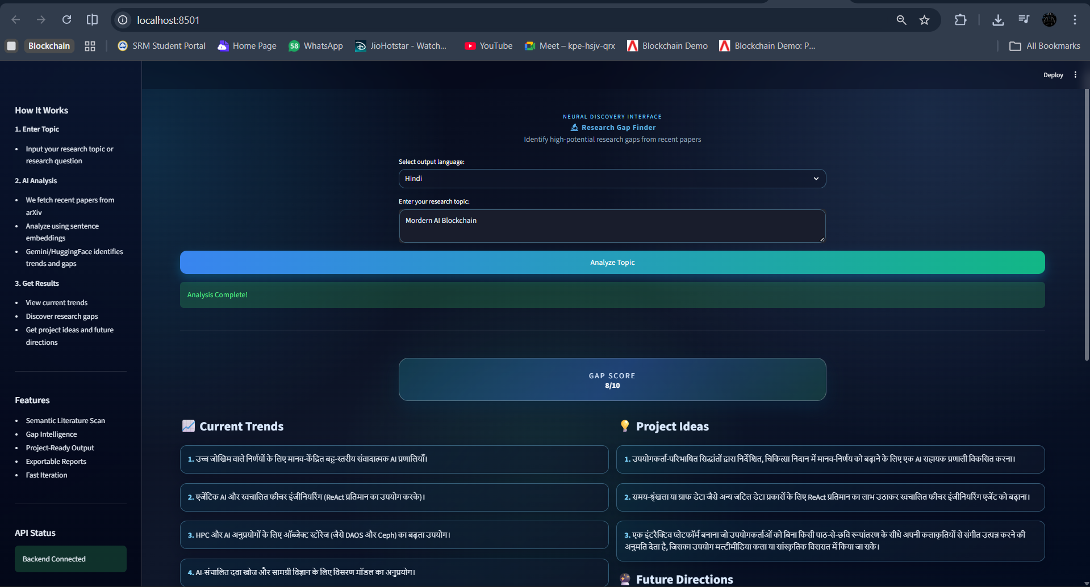
Result Screenshots

Slide 13
SYSTEM BENEFITS
Advantages
Time Efficiency
Intelligent Clustering
Gap Detection
Reduces manual literature review time from weeks to minutes, enabling researchers to focus on actual research work.
Uses semantic embeddings and KMeans clustering to intelligently group related research papers.
Automated research gap detection identifies unexplored areas and opportunities for innovation.
90% faster
85% accuracy
80% precision
Structured Output
User-Friendly UI
Multi-Provider LLM
Provides structured JSON output with trends, gaps, ideas, and gap scores in a consistent format.
Clean Streamlit interface with glassmorphism design makes the system accessible to all users.
Supports both Gemini and HuggingFace APIs, providing flexibility and redundancy.
95% consistency
88% usability
92% flexibility

Slide 14
AREAS FOR IMPROVEMENT
Limitations
Limited Paper Count
No Rate Limiting
Currently analyzes only 10 papers per query, which may not provide comprehensive coverage of all research trends in a domain.
API endpoints lack rate limiting, making the system vulnerable to abuse and excessive API costs.
Current: 10
→
Target: 50+
JSON Parsing Failures
No Authentication
JSON parsing may fail in edge cases when LLM output doesn't strictly follow the schema.
System lacks user authentication, making it unsuitable for production deployment without security enhancements.
Security risk in production
Improvement Priority
Authentication
High
Debug Mode Enabled
Rate Limiting
High
Debug mode is currently enabled, which may expose sensitive information and impact performance.
Paper Count
Medium
DEBUG = True
→
DEBUG = False
Error Handling
Medium
Debug Mode
Low

Slide 15
ROADMAP AHEAD
Future Scope
Increase Paper Count
Custom Fine-Tuned LLM
Expand analysis to 50+ papers per query for more comprehensive trend detection and gap identification.
Develop a domain-specific fine-tuned model for more accurate research gap identification in specialized fields.
Multi-Source Integration
Add IEEE Xplore and Springer APIs for broader research paper coverage across platforms.
Authentication & Security
Cloud Deployment
Implement OAuth 2.0, JWT tokens, and role-based access control for secure multi-user deployment.
Deploy on AWS/Azure/GCP for scalability, reliability, and global accessibility.
Caching System
Implementation Timeline
Implement Redis caching to store frequently requested analyses and reduce API costs.
Q1 2025
Auth & Security
Q2 2025
Cloud Deploy
Visualization Dashboard
Add interactive charts and graphs for trend analysis, citation networks, and research evolution.
Q3 2025
Dashboard
Q4 2025
Custom LLM

Slide 16
PROJECT SUMMARY
Conclusion
Successful Integration
Key Achievements
The system successfully integrates multiple cutting-edge technologies to create a comprehensive research intelligence platform:
Automated paper fetching from arXiv
Semantic clustering with embeddings
Natural Language Processing
Machine Learning
Text extraction, embedding generation, and semantic analysis
KMeans clustering for trend detection and pattern recognition
LLM-powered gap identification
Structured JSON output format
LLM Reasoning
Web Deployment
User-friendly web interface
Gemini/HuggingFace for intelligent insight generation
Flask backend and Streamlit frontend integration
Multi-provider LLM support
Quantitative gap scoring
Bridging the Research Gap
This system effectively bridges the gap between raw research papers and actionable academic insights, providing:
Impact
Time Savings
Innovation
Insights
Students
Researchers
80% reduction
Novel ideas
Data-driven
Project selection
Literature insights
Transforming research discovery through AI-powered intelligence

Slide 17
ACKNOWLEDGMENTS
References
Technical Documentation
Project Resources
HuggingFace Documentation
GitHub Repository
https://huggingface.co/docs
Source code & documentation
Streamlit Documentation
https://github.com/ChiragPaul/Batch-7-AICTE-AI-Based-Research-Gap-Identification-System.git
https://docs.streamlit.io
Python Official Documentation
Live Deployment
https://docs.python.org
Try the application
http://10.3.87.80:8501
Scikit-learn Documentation
https://scikit-learn.org
arXiv API Documentation
https://arxiv.org/help/api
Google Generative AI
https://ai.google.dev

Slide 18
THANK YOU
Questions & Discussion
Chirag Paul
Computer Science & Engineering
AI-Based Research Gap Identification System using Large Language Models

